Slide 1

LIBRARY MANAGEMENT SYSTEM

Slide 2
Objective of the Project
Objective: To design and implement a relational database for a library.
Purpose:
To store, organize, and retrieve information about books, members, and transactions (issue/return).
To automate manual tasks such as maintaining records, tracking availability, and calculating fines.
To ensure data accuracy, consistency, and security through relational database design.
To provide easy access and search functionality for both librarians and users.
To support reports and analytics on book inventory, usage trends, and member activity.
To design and implement a database-driven system for managing library operations efficiently.

Slide 3
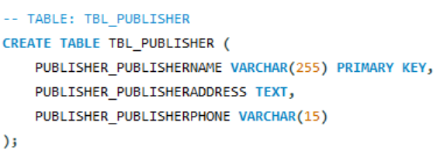
Database Schema
Publisher Table
Each publisher is uniquely identified by its name.
Holds address & phone details.

Slide 4
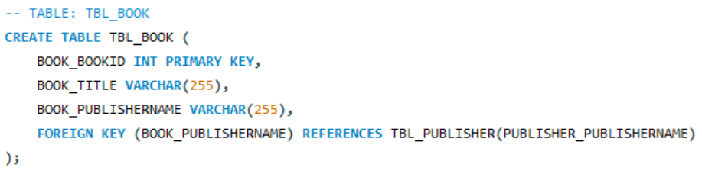
Books Table
Stores all books in the library.
Linked to Publisher via book_PublisherName.

Slide 5
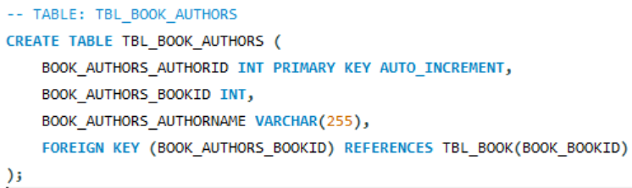
Authors Table
Each Book can have multiple Authors.
AUTO_INCREMENT ensures unique IDs for authors.

Slide 6
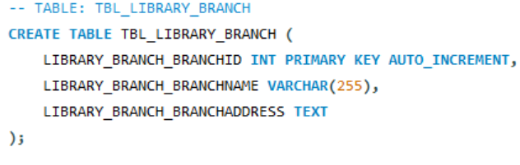
Library Branches Table
Stores branch details (different locations of the library).

Slide 7
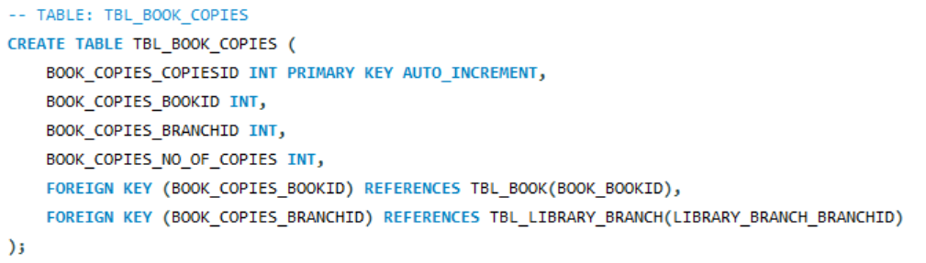
Book Copies Table
Keeps how many copies of a book exist in each branch.
Connects Books with Library Branches.

Slide 8
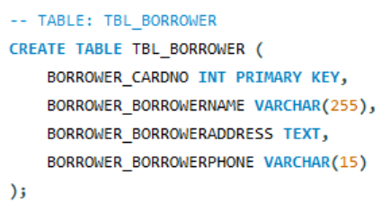
Borrower Table
Library members who borrow books.
Identified by Card Number.

Slide 9
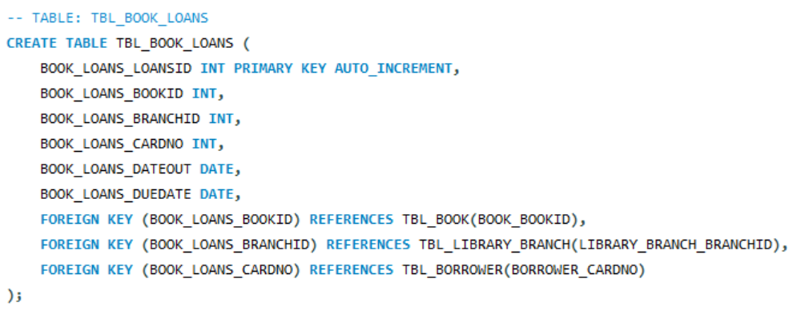
Loans Table
Tracks which borrower borrowed which book, from which branch, and for how long.

Slide 10
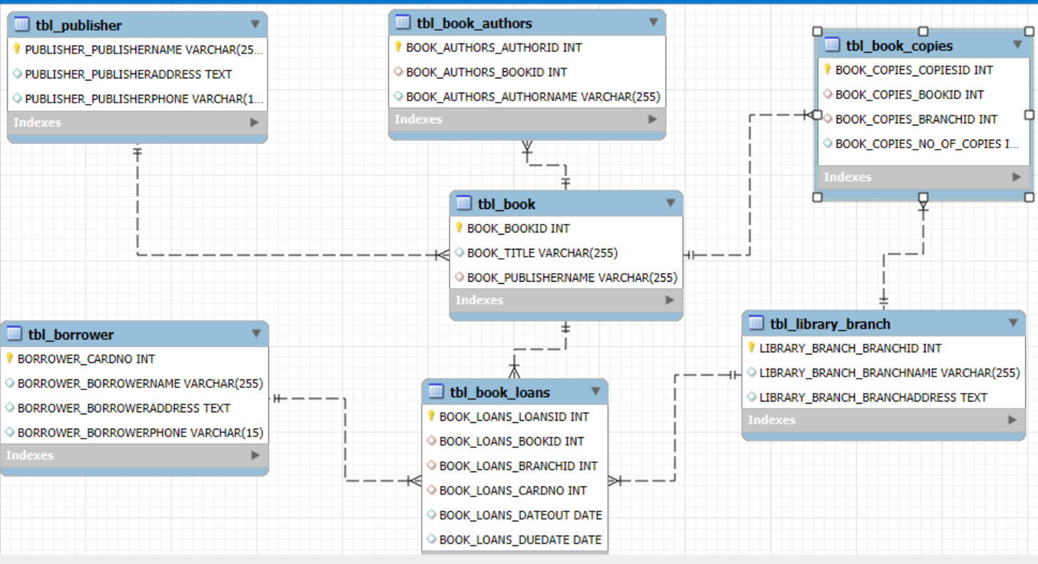
ER Diagram

Slide 11
TABLE RELATIONSHIPS
Publisher → Book → 1:M
Book ↔ Author → M:N (via tbl_book_authors)
Library Branch → Book Copies → 1:M
Book → Book Copies → 1:M
Borrower → Book Loans → 1:M
Book → Book Loans → 1:M
Library Branch → Book Loans → 1:M

Slide 12
KEY ANALYSIS QUESTIONS
How many books does each publisher provide to the library?
Which authors have written the most books available in the library?
Which branch has the maximum number of copies of a particular book?
Which branch issues the maximum number of loans?
Average loan duration for borrowers (DateOut → DueDate difference)?
Borrowers with no current loans?

Slide 13
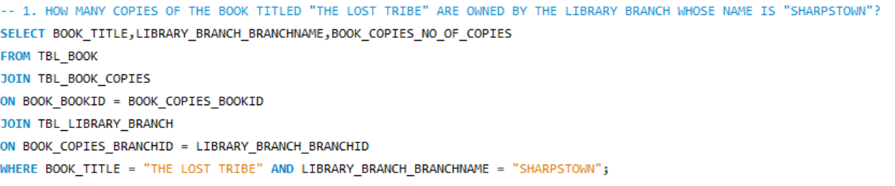
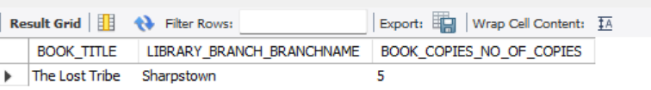
ANALYSIS FINDINGS

Slide 14
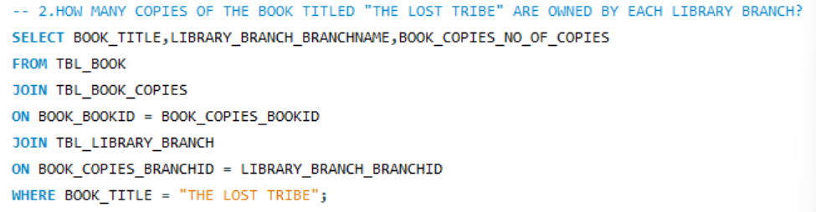
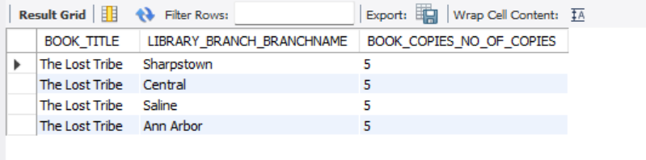

Slide 15
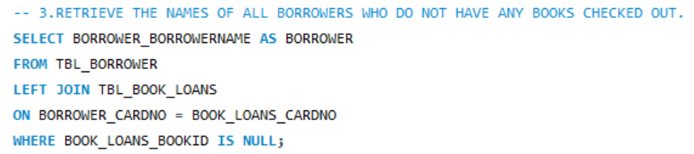
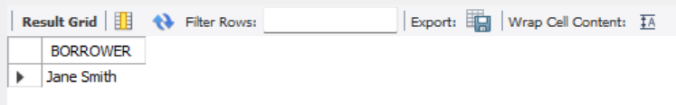

Slide 16
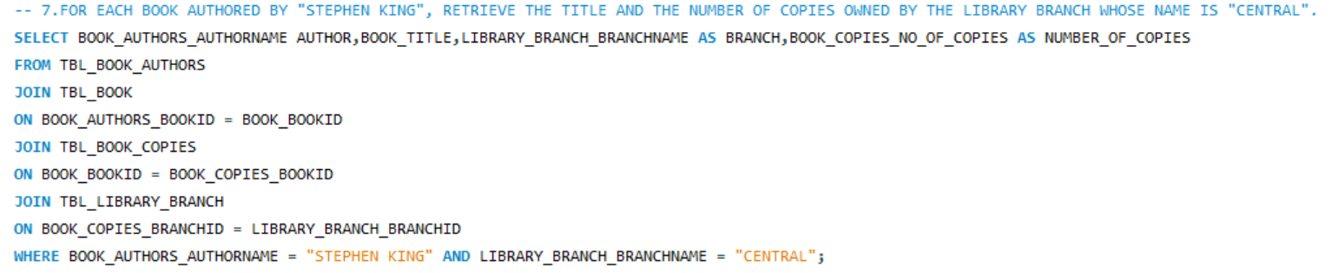
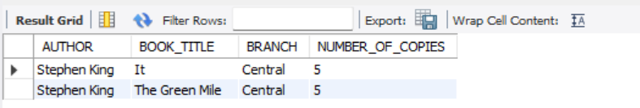

Slide 17
INSIGHTS
Bloomsbury Has Published Maximum Number Of Books.
Tom Li Has Borrowed Maximum Number Of Books(13).
Each Library Branch Holds 100 Copies Of All Books in Total.

Slide 18
RECOMMENDATIONS
Improve branch-level stock distribution.
Implement SMS/email reminders for overdue books.
Introduce data dashboards for real-time tracking.
Promote low-demand books via events or highlights.
Use data to plan future book purchases.

Slide 19
CONCLUSION
The Library Management System provides an efficient, data-driven view of library operations from books and borrowers to branches and publishers.
Book demand analysis shows the borrowing trends.
Overdue records suggest the need for better borrower communication and reminder systems.
Author and publisher data reveal that a few key contributors drive most of the readership.
Implementing recommendations like inventory optimization, borrower engagement, and data dashboards will make library management smarter and more efficient.
Overall, the system enables strategic decision-making, cost efficiency, and enhanced user satisfaction for both librarians and readers.

Slide 20
Q&A
Any Questions…???

Slide 21
EXPERIENCE & CHALLENGES
I realized how important database design is before starting analysis.
Writing efficient SQL queries and using the right relationships made the analysis accurate and meaningful. It helped me understand how data is structured, linked, and queried in an actual system.
ensuring one-to-many and many-to-many relations were set up properly using foreign keys.
avoiding duplicate or orphan records when creating foreign key constraints.
especially when joining multiple tables to find insights like the most borrowed books or overdue borrowers.
making sure data types matched between tables (like INT vs VARCHAR).

Slide 22

THANK YOU

